Slide 1
CSCI2520 Tutorial 6 Selection Problem
Pan Zhenyu
zypan24@cse.cuhk.edu.hk
Slide Ack: modified based on the slides from Li Hui

Slide 2
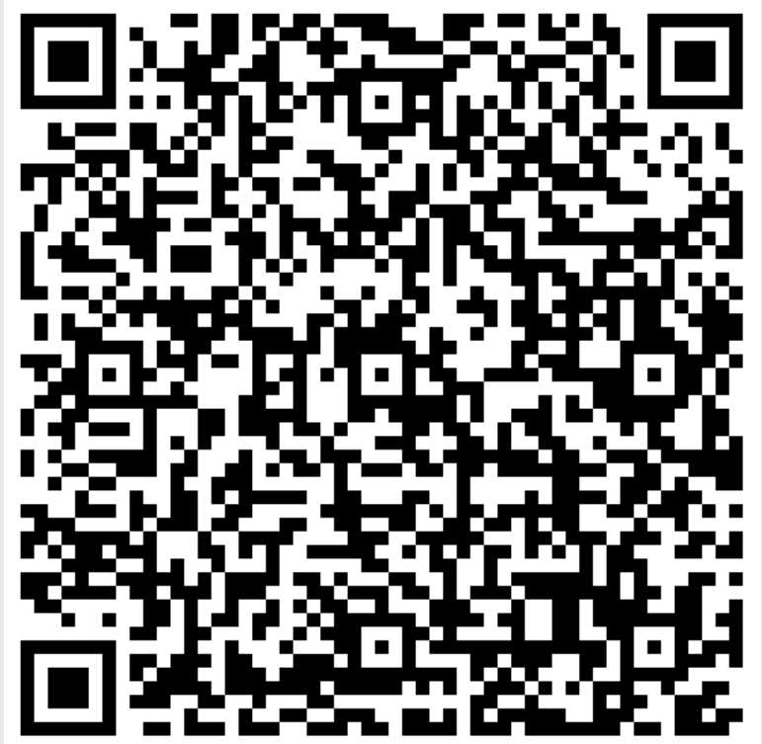
1st Midterm Feedback Survey
https://docs.google.com/forms/d/e/1FAIpQLSdPmwH3oIzRxZpwW-1XebTrdTnOyDGjTdPOwpnPqgwnmgwi6Q/viewform?usp=header

Slide 3
Outline
Selection Problem
Two Naive Approaches
Quickselect – extension of quicksort

Slide 4
Selection Problem
A selection algorithm is an algorithm for finding the kth smallest element in a list.
For example
For array (11, 6, 43, 7, 14, 28, 9, 2, 4, 37, 18, 34, 8)
What’s the answer if k = 3? k = 7? k = 1? k = 13?
Question: what value of k makes the problem simplest?

Slide 5
Selection Problem
Special cases for selection problem: find the minimum/maximum of a list.
How to solve it? Easy!
Question: what is the complexity?
Func FindMinimum(arr: list, n: int):
min = INT_MAX
for i from 0 to n-1:
if arr[i] < min:
min = arr[i]
i = i + 1
return min

Slide 6
Selection Problem
Special cases for selection problem: find the minimum/maximum of a list.
How to solve it? Easy!
Question: what is the complexity? O(n)
Func FindMinimum(arr: list, n: int):
min = INT_MAX
for i from 0 to n-1:
if arr[i] < min:
min = arr[i]
i = i + 1
return min

Slide 7
Two Naive Approaches
How to find kth smallest element of a list?

Slide 8
Two Naive Approaches
How to find kth smallest element of a list?
Sort the array and go to the kth position.
Find the smallest element, remove it from the list, and find the (k-1)th smallest element in the remaining list.

Slide 9
Exercise 1
Implement the second approach with the following prototype.
find the smallest element
remove it from the list
find the (k-1)th smallest element in the remaining list.
Func FindKthElement(arr: list, n: int, k: int)

Slide 10
Exercise 1 Solution
Func FindKthElement(arr: list, n: int, k: int):
i, j, iMin, tmp = 0
for i = 0 to k-1:
iMin = i
for j = i + 1 to n-1:
if (arr[j] < arr[iMin])
iMin = j
j = j + 1
tmp = arr[i]
arr[i] = arr[iMin]
arr[iMin] = tmp
i = i + 1
return arr[k - 1]
Round i
Find the index iMin such that arr[iMin] is the smallest in arr[i … n-1]
Exchange arr[i] and arr[iMin]
Round i: find the smallest element in
arr[i … n-1] and exchange it with arr[i].

Slide 11
This is very similar to …
Func SelectionSort(arr: list, n: int):
i, j, iMin, tmp = 0
for i = 0 to n – 1:
iMin = i
for j = i + 1 to n – 1:
if arr[j] < arr[iMin]:
iMin = j
j = j + 1
tmp = arr[i]
arr[i] = arr[iMin]
array[iMin] = tmp
i = i + 1
Round i
Find the index k such that arr[k] is the smallest in arr[i … n-1]
Exchange arr[i] and arr[k]
Round i: find the smallest element in
arr[i … n-1] and exchange it with arr[i].

Slide 12
Two Naive Approaches
How to find kth smallest element of a list?
Sort the array and look up.
Partial selection sort.
Question: what are the complexities of them (suppose array length is n)?

Slide 13
Two Naive Approaches
Sort the array and look up.
Sorting takes O(nlogn) (merge sort, quicksort …)
Looking up to kth position takes O(1)
Totally, O(nlogn)
Partial selection sort.
Round i needs (n-i) comparisons and takes O(n)
There totally k rounds. Thus, O(kn)
Question: which one is better?

Slide 14
Two Naive Approaches
Which one is better? It depends!
If k is small (e.g., 1 or 3, i.e., k = O(1)), O(kn) = O(n) < O(nlogn). Then, partial selection sort is better.
If k is very big (e.g. n-1 or n-3)?
If we want to find the median, k = n/2 = O(n), O(kn) = O(n²) > O(nlogn). Then merge sort or quicksort is better.

Slide 15
Quickselect
A complete sorting can always solve the problem. However, for selection sort, it is enough to stop in the middle (after k rounds).
Selection sort can be extended to partial selection sort for “selection” problem. How about other sorting algorithms?
Let’s look at quicksort!

Slide 16
The Quicksort Algorithm
For “selection”, are both recursive calls necessary?
56 | 25 | 37 | 58 | 95 | 19 | 73 | 30
partitioning
All values < 56
All values ≥ 56
19 | 25 | 37 | 30 | 56 | 95 | 73 | 58
Recursively sort
Recursively sort
19 | 25 | 30 | 37 | 56 | 58 | 73 | 95
sorted
pivot

Slide 17
The Quickselect Algorithm
If k is smaller than the position of pivot (5 in this example), left part is enough!
56 | 25 | 37 | 58 | 95 | 19 | 73 | 30
partitioning
All values < 56
All values ≥ 56
19 | 25 | 37 | 30 | 56 | 95 | 73 | 58
Recursively select
19 | 25 | 30 | 37

Slide 18
Quicksort: Example Run
56 | 25 | 37 | 58 | 95 | 19 | 73 | 30
19 | 25 | 37 | 30
56
95 | 73 | 58
19
25 | 37 | 30
58 | 73
95
Left subarray
Pivot
25
37 | 30
58
73
Right subarray
Virtual merge
30
37
Done and sorted!
19 | 25 | 30 | 37 | 56 | 58 | 73 | 95

Slide 19
Quickselect: Example Run
find the 2-th smallest value in this array
56 | 25 | 37 | 58 | 95 | 19 | 73 | 30
find the 2-th smallest value in the left subarray
19 | 25 | 37 | 30
56
95 | 73 | 58
find the 1-th smallest value in the right subarray
19
25 | 37 | 30
pivot is the 1-th smallest!
25
37 | 30
Left subarray
Pivot
Right subarray

Slide 20
Exercise 2
Implement quickselect with the following prototype
Hint: quicksort is like this …
Func Quickselect(arr: list, n: int, k: int)
Func Quicksort(arr: list, n: int):
if n > 1:
p = Partition(arr, n)
Quicksort(arr, p)
Quicksort(arr[p + 1:], n - p - 1)

Slide 21
Exercise 2 Solution
A test to stop or continue
Func Quickselect(arr: list, n: int, k: int):
if n == 1
return arr[0]
else:
p = Partition(arr, n)
if (k - 1) < p:
return Quickselect(arr, p, k)
else
return Quickselect(arr[p + 1:], n - p - 1, k - p - 1)
An end case
Two recursive calls
Two recursive calls

Slide 22
Quickselect Complexity (Optional)
Computational complexity of quickselect is similar to that of quicksort. The time for partition is O(n).
In the worst case, target subarray is much larger than the other. There are O(n) levels. Each level executes in O(n) time. Thus, worst case time complexity is O(n²).
array
O(N) levels

Slide 23
Quickselect Complexity (Optional)
In average case, the left and right subarrays have equal size.
There are at most log n levels. Each level executes in ? time. Thus, average case time complexity is ?.
array
At most log n levels

Slide 24
Quickselect Complexity (Optional)
Intuitively, it is n + n/2 + n/4 + … + 1 = 2n-1 = O(n)
Strictly, average case time complexity T(n) = O(n) + T(n/2)
T(n) ≤ c × n + T(n/2)
T(n/2) ≤ c × n/2 + T(n/4)
T(n/4) ≤ c × n/4 + T(n/8)
……
T(2) ≤ c × 1 + T(1)
T(1) = c’
So, T(n) ≤ c × (n + n/2 + n/4 + … + 1) + c’ = c × (2n-1) + c’
T(n) = O(n)!

Slide 25
Summary
Sort
bubble sort: O(n²)
selection sort: O(n²)
merge sort: O(nlogn)
quicksort: O(nlogn) (average), O(n²) (worst)
Selection
partial selection sort: O(kn)
merge sort and look up: O(nlogn)
quickselect: O(n) (average), O(n²) (worst)

Slide 26
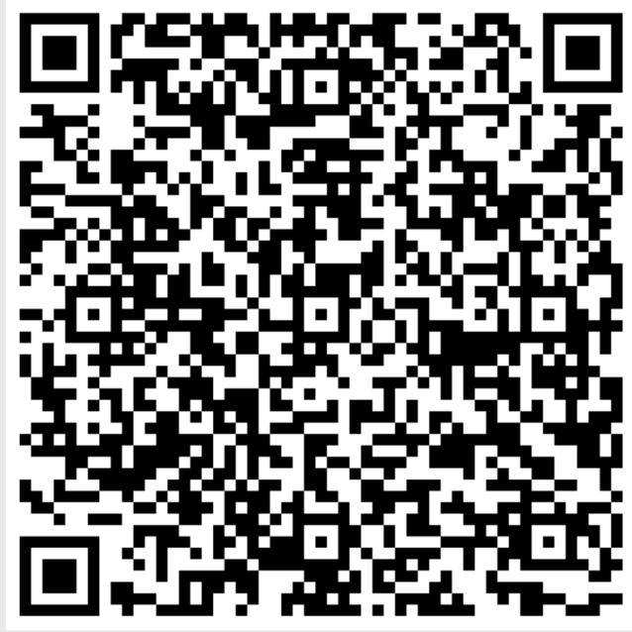
Help Us Shape Your Learning Experience!
https://docs.google.com/forms/d/e/1FAIpQLSeQae3jZ9up030JrhCl7LyjZAr3PGCvO0NQo0zzIhaL0jOeOg/viewform?usp=header

